Slide 1
Topics to be covered
Architecture of 8255
Interfacing of ADC with 8086 microprocessor
Interfacing of DAC with 8086 microprocessor
Architecture of 8253
Architecture of 8251
Architecture of 80286
Architecture of 80386
Features of 80586

Slide 2
8255: Programmable Peripheral Interface
It is used as an interface between processor and I/O devices.
8086
Micro-processor
8255
PPI
I/O
Devices

Slide 3
Features of 8255
It has three 8-bit bi-directional I/O ports: Port A, Port B, and Port C.
It provides 3 modes of data transfer:
1) Mode0: Simple I/O
2) Mode1: Handshake I/O
3) Mode2: Bi-directional Handshake.
Additionally it also provides a Bit Set Reset Modes to alter individual bits of Port C.

Slide 4
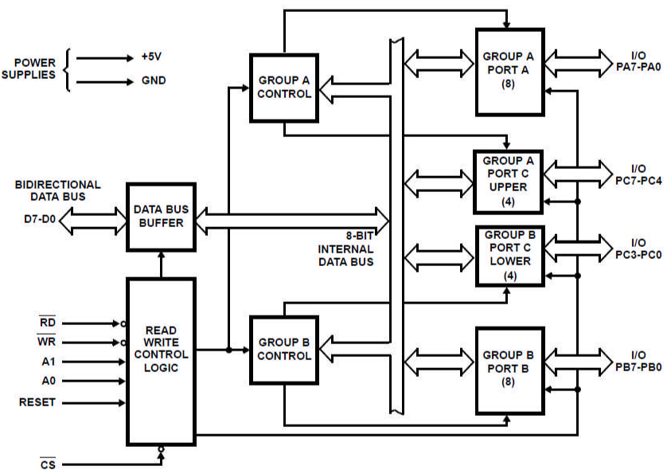
ARCHITECTURE OF 8255

Slide 5
Data Bus Buffer
This is a 8-bit bi-directional buffer used to interface the internal data bus of 8255 with the external (system) data bus.
The CPU transfers data to and from the 8255 through this buffer.
Read/Write Control Logic
It accepts address and control signals from the µP.
The Control signals determine whether it is a read or a write operation and also select or reset the 8255 chip.
Group A Control
This Control block controls Port A and Port C_{Upper} i.e. PC₇-PC₄.
It accepts Control signals from the Control Word and forwards them to the respective Ports.
Group B Control
This Control block controls Port B and Port C_{Lower} i.e. PC₃-PC₀.
It accepts Control signals from the Control Word and forwards them to the respective Ports.

Slide 6
The Address bits (A2, A1) of 8086 microprocessor are connected to A1 and A0 of 8255 to select the Ports or the Control Word Register.
A7 | A6 | A5 | A4 | A3 | A2 | A1 | A0 | Address | Selection
1 | 0 | 0 | 0 | 0 | 0 | 0 | 0 | 80 | PA
1 | 0 | 0 | 0 | 0 | 0 | 1 | 0 | 82 | PB
1 | 0 | 0 | 0 | 0 | 1 | 0 | 0 | 84 | PC
1 | 0 | 0 | 0 | 0 | 1 | 1 | 0 | 86 | CW

Slide 7
Modes of 8255
D7th bit of Control Word
0: BSR MODE
1: IO MODE
Mode mode Mode
0 1 2

Slide 8
IO Modes of 8255
Port | Mode 0 | Mode 1 | Mode 2
Port A | Yes | Yes | Yes
Port B | Yes | Yes | No (Mode 0 or Mode 1)
Port C | Yes | No (Handshake signals) | No (Handshake signals)

Slide 9
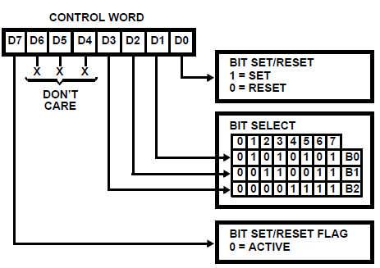
CONTROL WORD OF 8255: BSR MODE used to set or reset the bits in PC
Ex: PC5: set
0 | 0 | 0 | 0 | 1 | 0 | 1 | 1

Slide 10
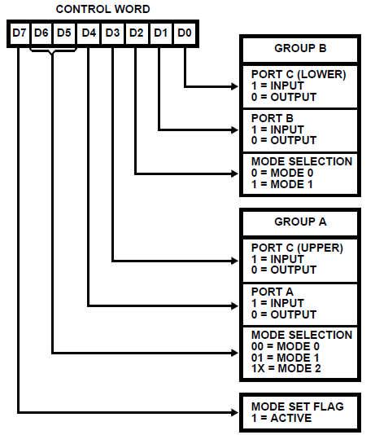
CONTROL WORD OF 8255: IO MODE
Ex: PA: Input port, mode2 PB: Output port, mode1 PC: Input port, mode0
1 | 1 | 0 | 1 | 1 | 1 | 0 | 1

Slide 11
Mode 0: Simple Bi-directional I/O
Port A and Port B used as 2 Simple 8-bit I/O Ports.
Port C is used as 2 simple 4-bit I/O Ports.
Each port can be programmed as input or output individually.
Ports do not have handshake or interrupting capability.
Mode 1 (Handshake I/O)
In Mode 1, handshake signals are exchanged between the devices before the data transfer takes place.
Port A and Port B used as 2 8-bit I/O Ports that can programmed in Input OR in output mode.
Each Port uses 3 lines from Port C for handshake. The remaining lines of Port C can be used for simple IO.

Slide 12
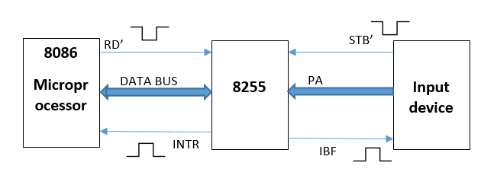
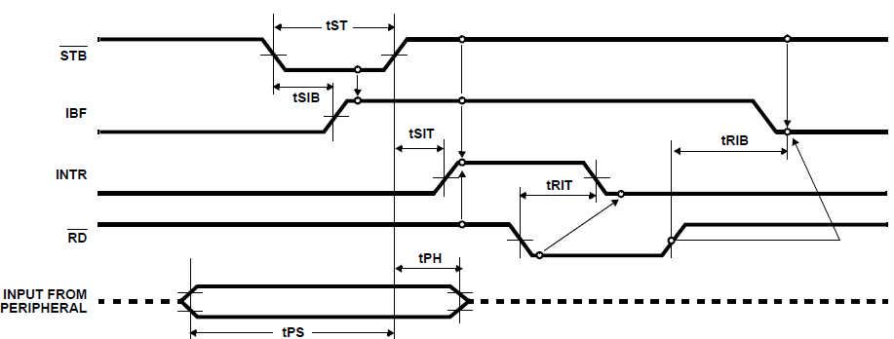
MODE1: INPUT HANDSHAKING
Timing Diagram for Mode 1 Input Transfer

Slide 13
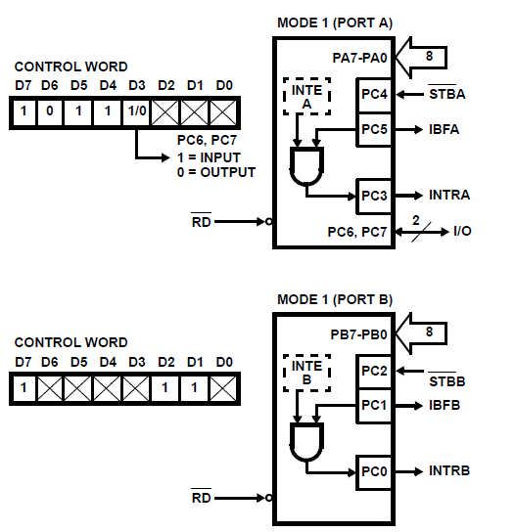
MODE1: INPUT HANDSHAKING

Slide 14
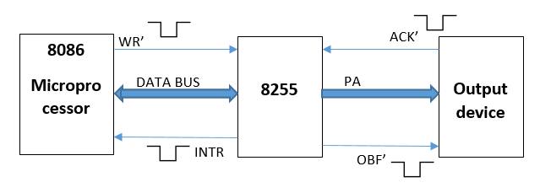
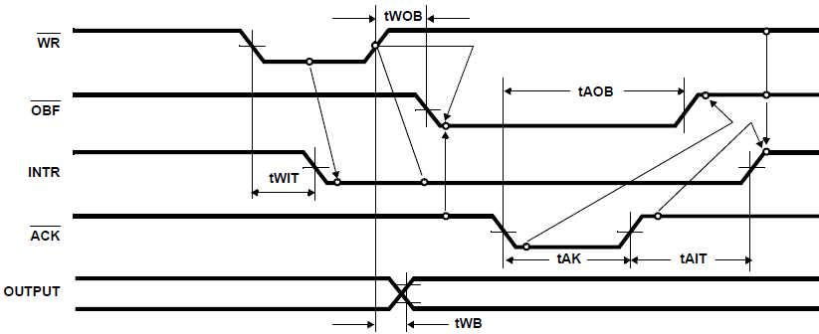
MODE1:OUTPUT HANDSHAKING
Timing Diagram for Mode 1 Output Transfer

Slide 15
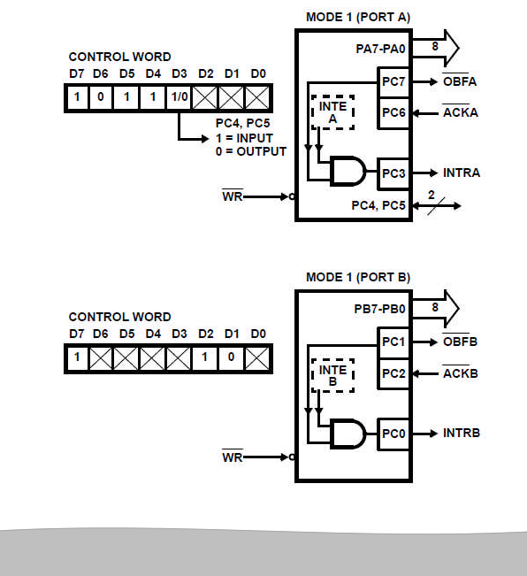
MODE 1: OUTPUT HANDSHAKING

Slide 16
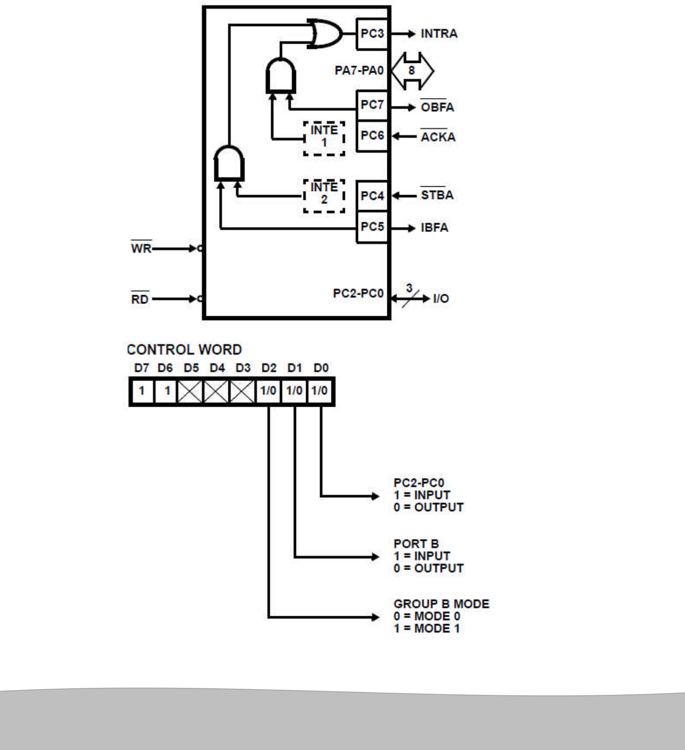
MODE 2: BIDIRECTIONAL HANDSHAKING Only Port A can operate in Mode 2. At that time Port B can operate in Mode 1 or Mode 0. Port C lines are again used up for performing Handshaking for Port A and Port B.

Slide 17
ADC 0808
ADC 0808 is an 8 channel, 8 bit ADC. It can convert an analog voltage input into an 8 bit digital data output.
To select an input out of 8 options, there are three select lines (C, B and A). We put a channel number on these lines (0…7) and latch it using ALE. (Once the channel is set, it should be enabled by making ALE high.)
SOC signal is given to ADC indicate start of conversion.
The end of conversion is indicated by the ADC using EOC signal.
Now give OE signal for enabling 8-bit data output from the ADC to 8255.
This data from 8255 is now transferred to the microprocessor. The process is repeated for subsequent channels, by changing the channel number. ADCs have a vast use in the modern electronic world for Data Acquisition Systems. They can be used for temperature sensing, voice recording, speed sensing

Slide 18
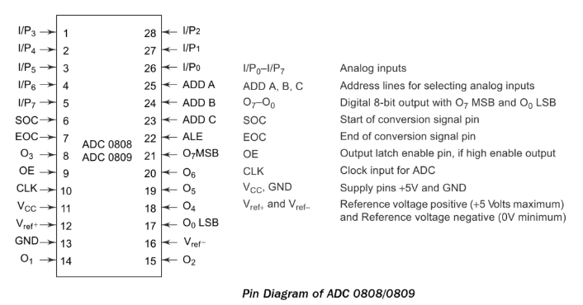
PIN DIAGRAM OF ADC 0808

Slide 19
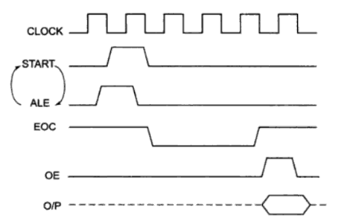
Channel Selection
Timing diagram of ADC0805
Address Lines |  |  | Analog input selected
C | B | A
0 | 0 | 0 | I/P0
0 | 0 | 1 | I/P1
0 | 1 | 0 | I/P2
0 | 1 | 1 | I/P3
1 | 0 | 0 | I/P4
1 | 0 | 1 | I/P5
1 | 1 | 0 | I/P6
1 | 1 | 1 | I/P7

Slide 20
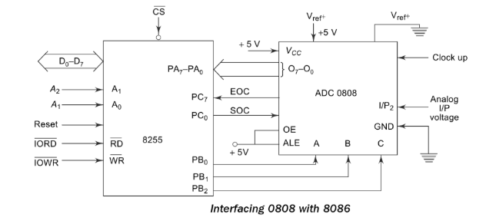
Interfacing of ADC0808 with 8086

Slide 21
PA: to read digital data from ADC (i/p) PB: to select the channel (o/p) PC0: SOC (o/p) PC7: EOC (i/p)
 | MOV AL, 98H | Initialize 8255
 | OUT CWR, AL
 | MOV AL,02H | Selected I/P 2 as analog input
 | OUT PORTB, AL
 | MOV AL, 00 H | Give Start of conversion Pulse to the ADC
 | OUT PORTC, AL
 | MOV AL, 01 H
 | OUT PORTC, AL
 | MOV AL, 00 H
 | OUT PORTC, AL
WAIT: | IN AL, PORTC | Check for EOC by reading port C upper and rotating through carry
 | RCL
 | JNC WAIT
 | IN AL, PORTA | If EOC, read digital equivalent is AL
 | HLT | Stop
IO | PA MODE |  | PA | PCU | PB MODE | PB | PCL
1 | 0 | 0 | 1 | 1 | 0 | 0 | 0

Slide 22
DAC 0808
DAC 0808 is an 8 bit Digital to Analog Converter. It can convert an 8 bit digital data input into an analog voltage output.
Reference voltage for conversion is provided using +Vref and –Vref. The output can be amplified (optional) using an op-amp.
DACs are used in various applications such as Waveform generation, PWM, Motor control Applications, DSP etc. Here we connect the output to a display device like a CRO.
The output from 0808 DAC is current, so we need current to voltage converter at output of DAC.

Slide 23
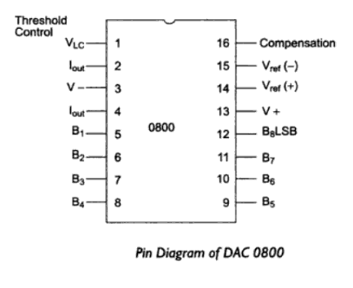
Pin diagram of DAC0808

Slide 24
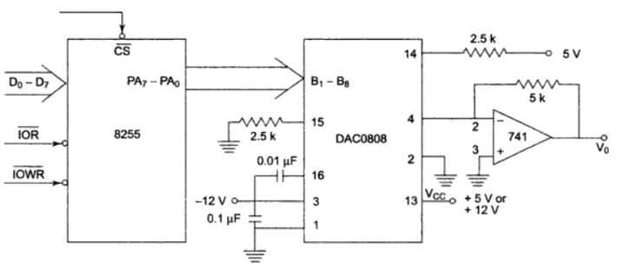
Interfacing of DAC0808 with 8086

Slide 25
 | MOV AL, 80 H | Configure PA as output port
 | OUT 46, AL
REPT: | MOV AL, 00 H | Start rising ramp from 0 to 2.5V i.e. 7F and send it to PA
BACK: | OUT 40, AL
 | INC AL
 | CMP AL, 7 FH
 | JNZ BACK | If ramp reaches 2.5V, then come out of loop
 | MOV AL, FFH | generate step of 5V for 5msec
 | OUT 40, AL
 | CALL DELAY
 | MOV AL, 7FH | Generate falling ramp from 2.5v to 0V
BACK 1: | OUT 40, AL
 | DEC AL
 | CMP AL, 00H
 | JNZ BACK1
 | JMP REPT
DELAY: | OUT 40, AL
BACK2: | INC BX
 | CMP BX, 04E2 H
 | JNZ BACK2
5v
2.5v
0v

Slide 26
8253: Programmable Interval Timer
Features of 8253:
8253 is used as a timer to generate time delay or as a counter.
Three independent 16-bit down counters.
Three counters can be programmed for either binary or BCD count
Counter can be programmed in six different modes.

Slide 27
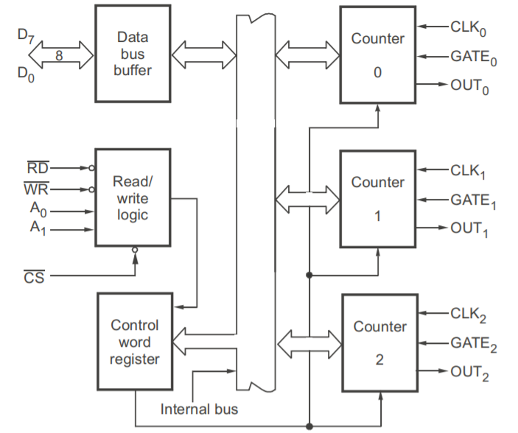
Architecture of 8253

Slide 28
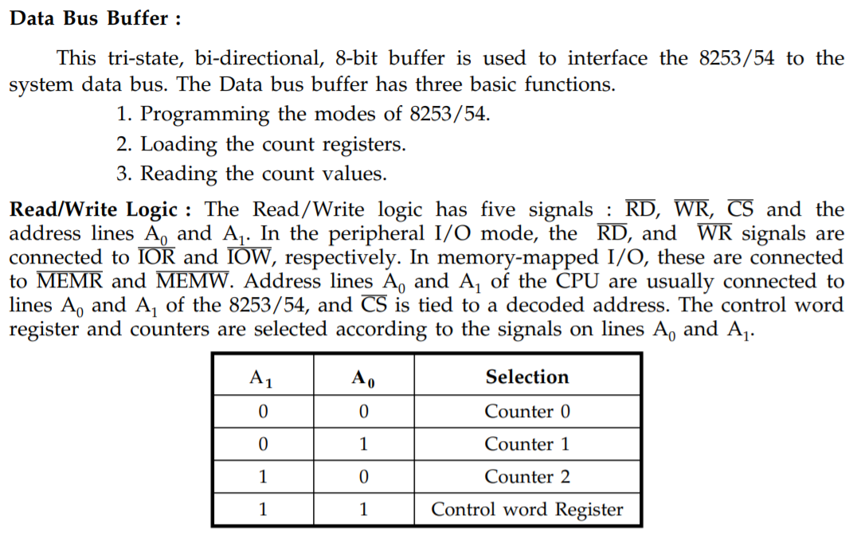

Slide 29
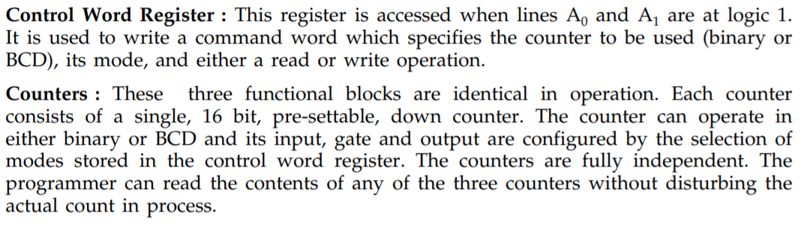
Each counter has the following signals:
Clk (Clock Input)
Gate(Gate Input)
Out (Clock Output)
The input clock signal is applied on the CLK line.
The counter decrements the "count value" on every pulse of the input clock at CLK.
When the count becomes zero (Terminal Count i.e. TC), the status of the OUT pin changes. This can be used to interrupt the µP.
The GATE pin is used to control the Counting.
In most modes, the count value gets decremented only if the GATE pin is high.

Slide 30
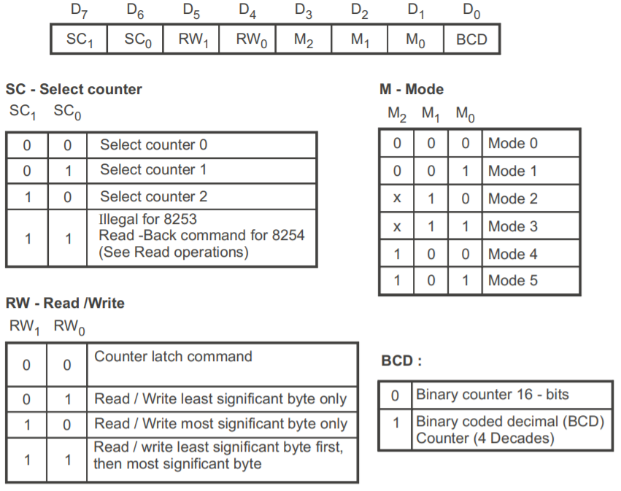
Control Word Register

Slide 31
Modes of 8253
Mode0: Interrupt on terminal count - s/w
Mode1: Mono stable multivibrator - h/w
Mode2: Rate generator – s/w
Mode3: Square wave generator – s/w
Mode4: Software triggered strobe – s/w
Mode5: Hardware triggered strobe – h/w

Slide 32
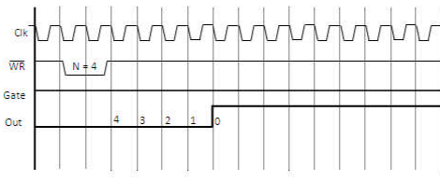
Mode0: Interrupt on terminal count

Slide 33
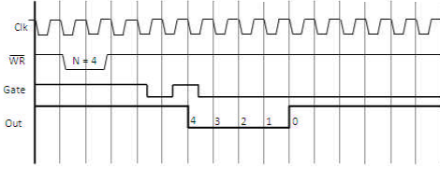
Mode1: Mono stable multivibrator

Slide 34
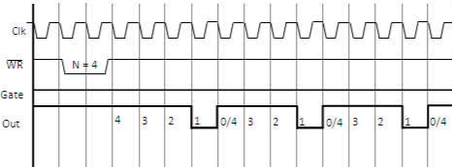
Mode2: Rate generator

Slide 35
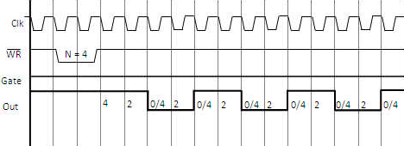
Mode3: Square wave generator

Slide 36
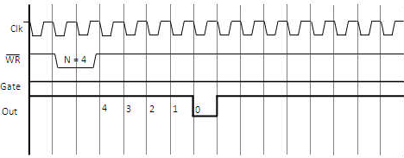
Mode4: Software triggered strobe

Slide 37
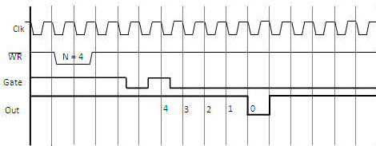
Mode5: Hardware triggered strobe

Slide 38
8251: USART
8251 universal synchronous asynchronous receiver transmitter (USART) acts as a mediator between microprocessor and peripheral to transmit serial data into parallel form and vice versa.
It takes data serially from peripheral (outside devices) and converts into parallel data.
After converting the data into parallel form, it transmits it to the CPU.
Similarly, it receives parallel data from microprocessor and converts it into serial form.
After converting data into serial form, it transmits it to outside device (peripheral).

Slide 39
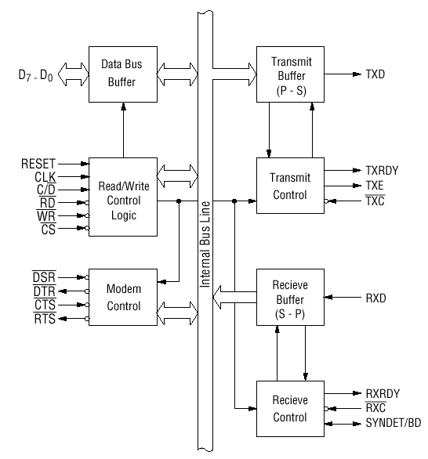
Architecture of 8251

Slide 40
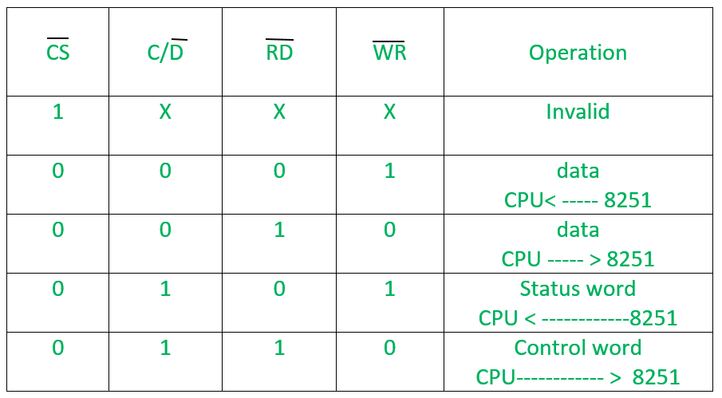
Data bus buffer : This block helps in interfacing the internal data bus of 8251 to the system data bus. The data transmission is possible between 8251 and CPU by the data bus buffer block.
2. Read/Write control logic: It monitors the data flow. This section has three registers and they are control register, status register and data buffer. It controls the overall working by selecting the operation to be done. The operation selection depends upon input signals as:

Slide 41
3. Transmitter
The transmitter section accepts parallel data from CPU and converts them into serial data.
The transmitter section is double buffered, i.e., it has a buffer register to hold an 8-bit parallel data and another register called output register to convert the parallel data into serial bits.
When output register is empty, the data is transferred from buffer to output register. Now the processor can again load another data in buffer register.
If buffer register is empty, then TxRDY is goes to high.
If output register is empty then TxEMPTY goes to high.
The clock signal, TxC (low) controls the rate at which the bits are transmitted by the USART.

Slide 42
4. Receiver
The receiver section accepts serial data and convert them into parallel data
The receiver section is double buffered, i.e., it has an input register to receive serial data and convert to parallel, and a buffer register to hold the parallel data.
The CPU reads the parallel data from the buffer register. When the input register loads a parallel data to buffer register, the RxRDY line goes high.
The clock signal RxC (low) controls the rate at which bits are received by the USART.
During asynchronous mode, the signal SYNDET/BRKDET will indicate the break in the data transmission.
During synchronous mode, the signal SYNDET/BRKDET will indicate the reception of synchronous character.

Slide 43
5. Modem control (modulator/demodulator) :
The MODEM control unit allows to interface a MODEM to 8251A and to establish data communication through MODEM over telephone lines.
A device converts analog signals to digital signals and vice-versa and helps the computers to communicate over telephone lines or cable wires. The following are active-low pins of Modem.
DSR: Data Set Ready signal is an input signal.
DTR: Data terminal Ready is an output signal.
CTS: It is an input signal which controls the data transmit circuit.
RTS: It is an output signal which is used to set the status RTS.

Slide 44
Features of 80286
It is a 16 bit Microprocessor
It has a 16 bit data bus.
It has 2 memory banks.
It has a 24 bit address bus.
It can access 16 MB memory.
It has 3 Pipeline stages - Fetch, Decode, Execute.
It operates on 6 MHz – 12 MHz frequency.

Slide 45
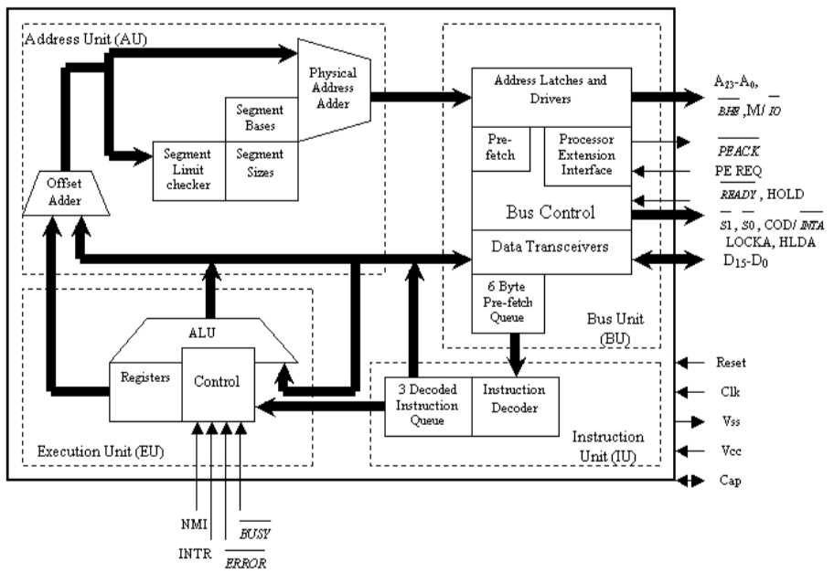
Architecture of 80286

Slide 46
Features of 80386
It is a 32 bit Microprocessor.
It has a 32 bit data bus.
It has 4 memory banks.
It has a 32 bit address bus.
It can access 4 GB memory.
It has 3 Pipeline stages- Fetch, Decode, Execute.
It operates on 16 MHz – 33 MHz frequency.

Slide 47
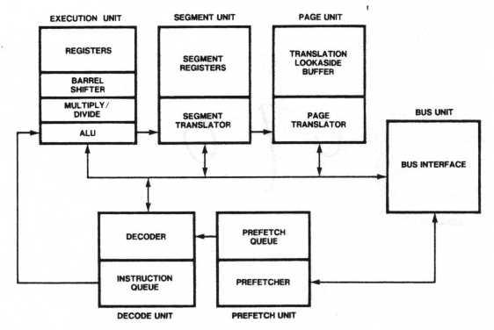
Architecture of 80386

Slide 48
Features of 80586
It is a 32 bit Microprocessor.
It has a 64 bit data bus.
It has 8 memory banks.
It has a 32 bit address bus.
It can access 4 GB of physical memory.
It has 5 Pipeline stages for integer operations.
It has an internal Floating point unit.
It has an 8 stage Floating point Pipeline.
It is 2 way superscalar. This means it has two pipes called the u-pipe and the v-pipe.
It operates on 66 MHz – 99 MHz frequency.
The Integer Pipeline stages are called: PF – Prefetch; D1 – Decode; D2 – Address Translation; EX – Execute; WR – Write Back.
It has a protection mechanism with 4 privilege levels.
It has on-chip L1 Code cache and L1 Data Cache both 8 KB each.
It has a branch prediction logic with a 256 entry Branch Target Buffer (BTB).

Slide 49
Comparison of 8086, 80286, 80386 and 80586
S No | Attribute | 8086 | 80286 | 80386 | 80586
1 | Processor Size | 16 – bit | 16 – bit | 32 – bit | 32 – bit
2 | Data Bus | 16 – bit | 16 – bit | 32 – bit | 64 – bit
3 | Memory Banks | 2 banks | 2 banks | 4 banks | 8 banks
4 | Address Bus | 20 – bit | 24 – bit | 32 – bit | 32 – bit
5 | Memory Size | 1 MB | 16 MB | 4 GB | 4 GB
6 | Pipeline Stages | 2 | 3 | 3 | 5
7 | ALU Size | 16 – bit | 16 – bit | 32 – bit | 32 – bit
8 | Operating | 6 MHz | 12 MHz | 33 MHz | 100 MHz
 | Frequency

Slide 50
Thank you

